Slide 1
Drawing in Java – part 2
Barb Ericson
Georgia Institute of Technology
September 2005

Slide 2
Learning Goals
Understand at a conceptual and practical level
  How to draw more simple shapes with java.awt.Graphics
    Arcs
    Rectangles
  Bitmapped pictures versus vector graphics
  How to use a java.awt.Graphics2D class
    How to convert the Graphics class to it
    How to set the color
    How to set the paint
    How to set the stroke (paint brush)
    How to create the object to be painted
    How to paint the object

Slide 3
Drawing Arcs
Arcs
  Outlined Arc
    g.drawArc(topLeftX, topLeftY, width, height, startAngle, arcAngle);
  Filled Arc
    g.fillArc((topLeftX, topLeftY, width, height, startAngle, arcAngle);
Notes:
The top left x and y in the ovals and arcs are for the top left corner of the bounding rectangle.
The arcAngle is the amount to add to the startAngle to get the endAngle.

Slide 4
Drawing Rectangles
Rectangle
  Outlined Rectangle
    g.drawRect(topLeftX, topLeftY, width, height);
  Filled Rectangle
    g.fillRect(topLeftX,topLeftY,width,height);
  Outlined Rounded Rectangle
    g.drawRoundRect(topLeftX,topLeftY,width,height,arcWidth,arcHeight);
  Filled Rounded Rectangle
    g.fillRoundRect(topLeftX,topLeftY,width,height,arcWidth,arcHeight);
Notes:
The topLeftX and topLeftY are the coordinates of the top left point of the enclosing rectangle for the rounded rectangle.
The arcWidth and arcHeight in the rounded rectangle are the width and height of the oval that creates the rounded part of the rectangle.
To draw a rectangle in the background color (clear the area).
g.clearRect(topLeftX,topLeftY,width,height);
To draw a 3-d rectangle (looks like a button)
g.draw3DRect(topLeftX, TopLeftY,width,height,isRaised);
g.fill3DRect(topLeftX,TopLeftY,width,height,isRaised);

Slide 5
Drawing on a Blank Picture
You can make pictures from the “blank” files
  They will have all white pixels
  640x480.jpg
  7inX95in.jpg
You can also create a “blank” picture with a width and height
  They will also have all white pixels
  Picture blankPicture = new Picture(width,height);

Slide 6
Draw a Picture Exercise
Create a method that will draw a simple picture
  Use at least one rectangle
  Use at least one polygon
  Use at least one oval
  Use at least one arc
Notes:
Should this be a class method or object method?

Slide 7
Bitmapped Versus Vector Graphics
We have been doing bitmapped graphics
  Specifying the color of each pixel in the picture
We just wrote a method that drew a simple picture
  Which is smaller the program or the picture?
Some applications use vector graphics which are programs that produce the picture
  Used in Postscript, Flash, and AutoCAD
  Advantages: smaller, easy to change, can be scaled

Slide 8

Precision Drawings
How would you draw a stack of filled rectangles starting from the lightest one at the bottom right and the darkest one at the top left.
  With 10 pixels between each
  Not easy with drawing packages

Slide 9
Draw Filled Rectangles Method
public void drawFilledRectangles()
{
Graphics g = this.getGraphics();
Color color = null;
// loop 25 times
for (int i = 25; i > 0; i--)
{
color = new Color(i * 10, i * 5, i);
g.setColor(color);
g.fillRect(0,0,i*10,i*10);
}
}
Notes:
Try drawing a series of filled ovals.

Slide 10
Java 2D Graphics – java.awt
Newer drawing classes
  More object-oriented
  Instead of drawOval() or fillOval() you create a Ellipse2D object and ask a 2d graphics object to draw or fill it
  Geometric shapes are in the java.awt.geom package
Advanced Drawing
  Support for different types of brushes
    Line thickness, dashed lines, etc
  Supports cubic curves and general paths
  Drawing of gradients and textures
  Move, rotate, scale and shear text and graphics
  Create composite images
Notes:
See http://java.sun.com/docs/books/tutorial/2d/ for the tutorial on 2d graphics from Sun.

Slide 11
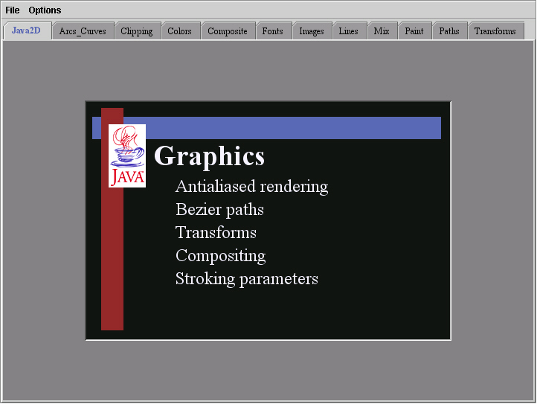
Java 2D Demo
Open a console window
Change directory to C:\jdk\demo\jfc\Java2D
Run the demo
  java –jar Java2Demo.jar
The source code is inC:\jdk\demo\jfc\Java2D\src

Slide 12
How To Use Java 2D
Cast the Graphics class to Graphics2D
  Graphics2D g2 = (Graphics2D) gObj;
Set up the stroke if desired (type of pen)
  g2.setStroke(new BasicStroke(widthAsFloat));
Set up a Color, GradientPaint, or TexturePaint
  g2.setPaint(Color.blue);
  g2.setPaint(blueToPurpleGradient);
  g2.setPaint(texture);
Create a geometric shape
  Line2D line2D = new Line2D.Double(0.0,0.0,100.0,100.0);
Draw the outline of a geometric shape
  g2.draw(line2d);
Fill a geometric shape
  g2.fill(rectangle2d);

Slide 13
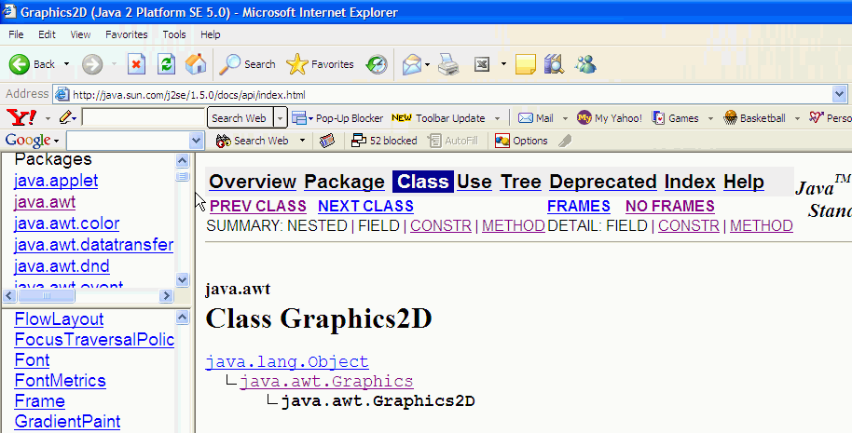
Graphics2D inherits from Graphics
Inherits basic drawing ability from Graphics
Adds more advanced drawing ability
Graphics
Graphics2D

Slide 14
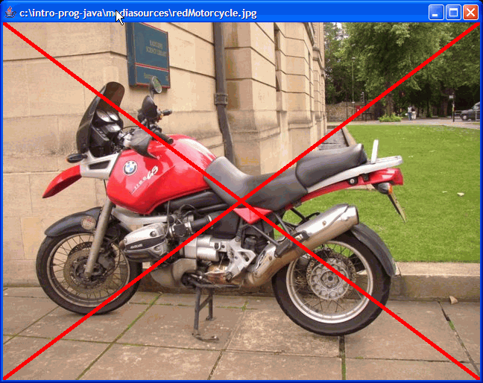
Drawing Lines Exercise
Create a new method (drawWideX) for adding two wide crossed lines to a picture
  Using a passed color
  Using a passed line width
Set up the stroke to make the lines thicker
  g2.setStroke(new BasicStroke(width));
  Draw the lines
You can use redMotorcycle.jpg to test.

Slide 15
Using a Graphics Object to Copy an Image
public void copy(Picture source, int x, int y)
{
// get the graphics object
Graphics g = this.getGraphics();
// copy the image
g.drawImage(source.getImage(),x,y,null);
}
Notes:
We had created a general copy method that copied a picture to a x and y location in the current picture but we had to copy all the pixels ourselves. But, there is a method that will do this for us in both Graphics and Graphics2D.

Slide 16
Using Graphics2D to Copy an Image
public void copy2D(Picture source, int x, int y)
{
// get the graphics object
Graphics g = this.getGraphics();
Graphics g2 = (Graphics2D) g;
// copy the image
g2.drawImage(source.getImage(),x,y,null);
}
Notes:
We had created a general copy method that copied a picture to a x and y location in the current picture but we had to copy all the pixels ourselves. But, there is a method that will do this for us in both Graphics and Graphics2D.

Slide 17
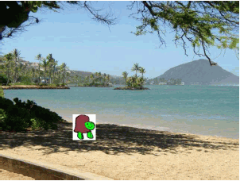
Testing the Copy Method
Picture p1 = new Picture(FileChooser.getMediaPath("beach.jpg"));
Picture p2 = new Picture(FileChooser.getMediaPath("turtle.jpg"));
p1.copy2D(p2,194,304);
p1.show();

Slide 18
Summary
You can use the original Graphics class for simple 2d drawing
  Lines, rectangles, ovals, polygons, strings, images
You can use the Graphics2D class for more advanced drawing
  Width of paint brush, paint geometric objects
Graphics2D inherits from Graphics
  Means it can do the same methods
  But also adds others

